Slide 1







Hope Haven Organization
About Us
Register
Login
The Smallest Act Of Kindness Is Worth More Than The Greatest Intention.
Copyright 2024

Slide 2


Hope Haven Organization
The Smallest Act Of Kindness Is Worth More Than The Greatest Intention.
Register
Login
OUR INSPIRATION
OUR AIM
Our inspiration came from realizing that people think donating takes a lot; they think it only takes millions to change lives. However, changing people’s situations can take just a rand and some second-hand clothes. The majority of us grew up around young and old people who find themselves in disadvantaged situations where they can’t provide for themselves and don’t have the power to change their circumstances. Hope Haven Organization can be the helping hand.
Our aim is to work as a middleman to supply essential items such as food, clothes, blankets, minor furniture, etc., to less privileged people. Our donors will first register and then log in. The donors select items they are willing to donate and specify if they are willing to deliver them or provide a location for us to pick them up. If it is money, banking details will be provided. Donors can individually track the items they have donated, as we are focusing not only on organizations but also on community members. For reassurance, our donors will be notified when their items will be delivered so they can witness the entire delivery process.
GROUP MEMBERS
1. Ntshuxeko Yvonne Mashava
2. Lucy Shai
3. Sandisiwe Mahanjana
4. Khanyi Nomadlozi
Copyright 2024

Slide 3


Hope Haven Organization
The Smallest Act Of Kindness Is Worth More Than The Greatest Intention.
Login
*
REGISTERING PAGE
* All Fields should be filled
First Name:
Lucy
*
Last Name:
Shai
*
Email:
lucyshai@gmail.com
*
Confirm Email:
lucyshai@gmail.com
*
Password:
Lucy@34
*
Confirm Password:
Lucy@34
*
REGISTER

Slide 4

WELCOME
Username
lucyshai@gmail.com
Password
*******
/
Forgot Password?
LOGIN

Slide 5
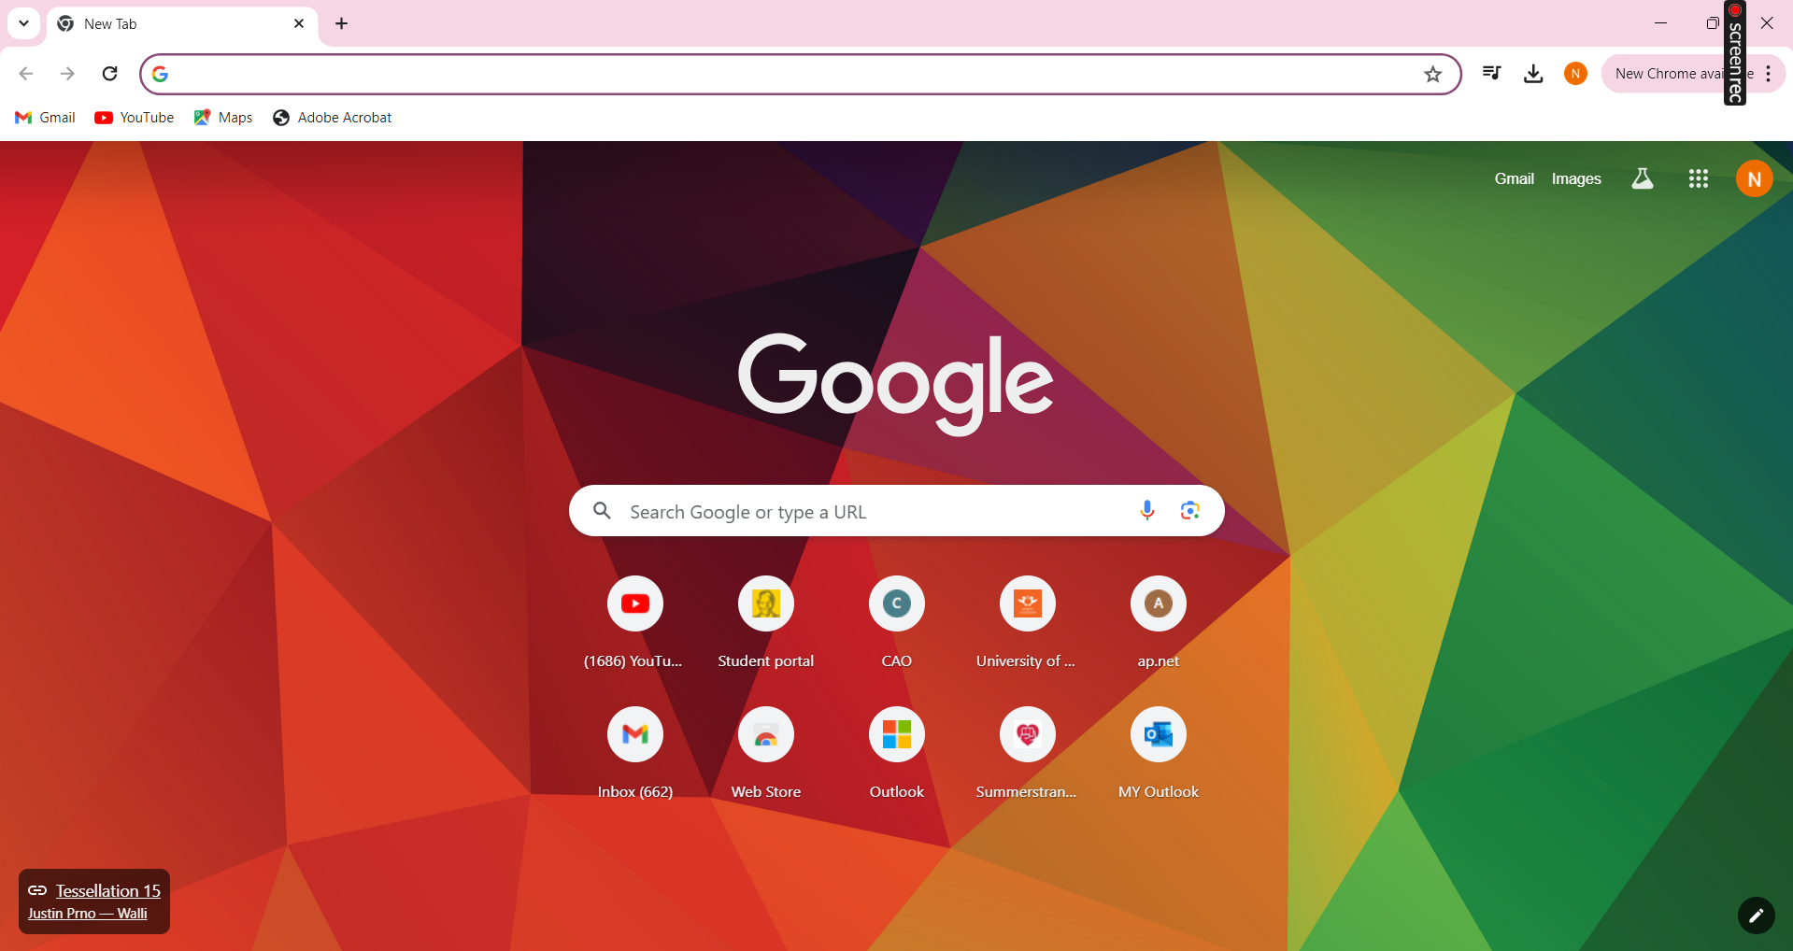

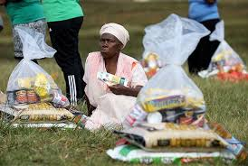
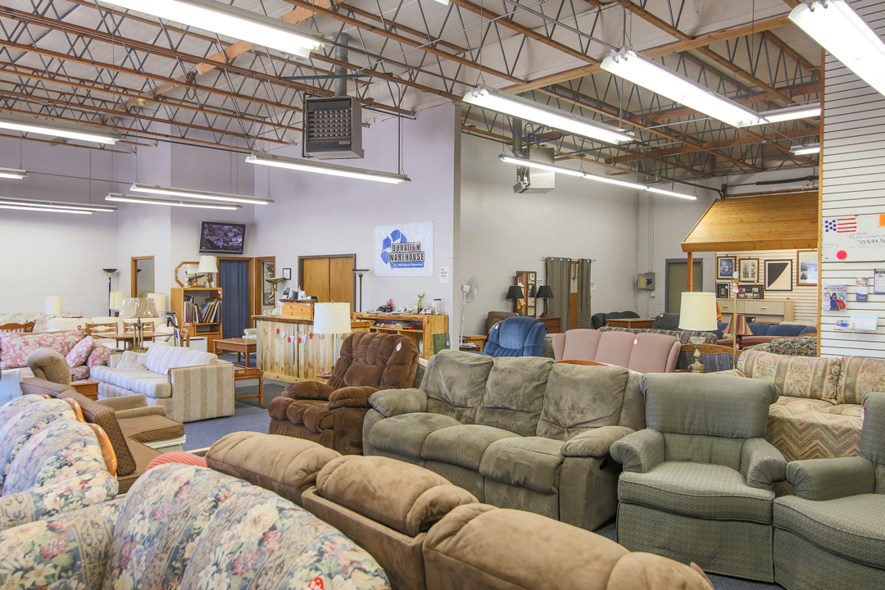





Hope Haven Organization
The Smallest Act Of Kindness Is Worth More Than The Greatest Intention.
Log out
DONATE FOOD
DONATE FURNITURE
DONATE CLOTHES
DONATE ANYTHING
Copyright 2024

Slide 6
Hope Haven Organization
The Smallest Act Of Kindness Is Worth More Than The Greatest Intention.
Log out
Copyright 2024

Slide 7

Hope Haven Organization
The Smallest Act Of Kindness Is Worth More Than The Greatest Intention.
Log out
DONATING FOOD
Donor Name:
Address line 1:
Organisation Name:
(Optional)
Address line 2:
(Optional)
Food Type:
Suburb:
Select delivery Option:
Delivery
Pickup
City:
Date:
Province:
Time:
Postal Code:
DONATE NOW
Copyright 2024

Slide 8
Hope Haven Organization
The Smallest Act Of Kindness Is Worth More Than The Greatest Intention.
Log out
DONATING FURNITURE
Donor Name:
Address line 1:
Organisation Name:
(Optional)
Address line 2:
(Optional)
Furniture Type:
Suburb:
Select delivery Option:
Delivery
Pickup
City:
Date:
Province:
Time:
Postal Code:
DONATE NOW
Copyright 2024

Slide 9
Hope Haven Organization
The Smallest Act Of Kindness Is Worth More Than The Greatest Intention.
Log out
DONATING CLOTHES
Donor Name:
Address line 1:
Organisation Name:
(Optional)
Address line 2:
(Optional)
Clothes Type:
Suburb:
Select delivery Option:
Delivery
Pickup
City:
Date:
Province:
Time:
Postal Code:
DONATE NOW
Copyright 2024

Slide 10
Hope Haven Organization
The Smallest Act Of Kindness Is Worth More Than The Greatest Intention.
Log out
DONATE ANYTHING
Donor Name:
Address line 1:
Organisation Name:
(Optional)
Address line 2:
(Optional)
Type:
Suburb:
Select delivery Option:
Delivery
Pickup
City:
Date:
Province:
Time:
Postal Code:
DONATE NOW
DONATE MONEY
Copyright 2024

Slide 11

Hope Haven Organization
The Smallest Act Of Kindness Is Worth More Than The Greatest Intention.
Log out
BANKING DETAILS
First Name:
Payment Type:
Last Name:
Credit Card Number:
Email:
Expiry Date:
(mm/yy)
Contact Number:
CVV:
PAY NOW
Copyright 2024

